Slide 1
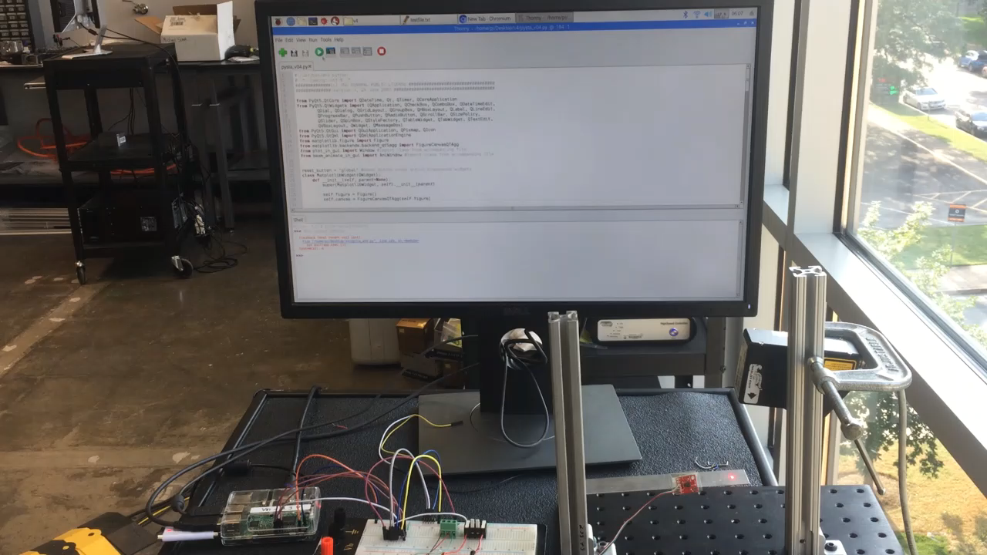
Demonstration – Data plotting

Slide 2
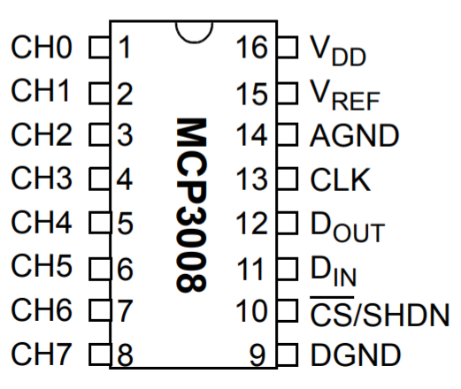
Hardware wiring
Connection of Analog-Digital-Converter
https://cdn-shop.adafruit.com/datasheets/MCP3008.pdf
Analog sensor connection side
Raspberry Pi connection side

Slide 3
Code Development: Signal Reading 1
Main library used: Adafruit_MCP3008 and SPI.SpiDev
Interface between Analog-Digital-Converter (MCP3008) and Raspberry Pi
Create an object:
mcp = Adafruit_MCP3008.MCP3008(spi=SPI.SpiDev(SPI_PORT,SPI_DEVICE))
…and read the data:
for i in range(0,8): # loop over all channels
values[i] = mcp.read_adc(i)*3.3/1024 # read and convert to Volts

Slide 4
Code Development: Signal Reading 2
Class Measurement():
def __init__(self, fs=100):
self.time = []
self.data = []
self.fs = fs
def setData(self, values)
def setTime(self, t0)
def saveData(self, data_type = ‘time_domain’, ‘name = testdata’)
def filterData(self, filter_options) future work

Slide 5
Code Development: GUI
Screenshot of GUI: Channel Select Tab

Slide 6
Code Development: GUI
Screenshot of GUI: Graph Tab

Slide 7
Code Development: GUI
Screenshot of GUI: Animation Tab

Slide 8
Code Development: GUI
Packages: Pyqt

Slide 9
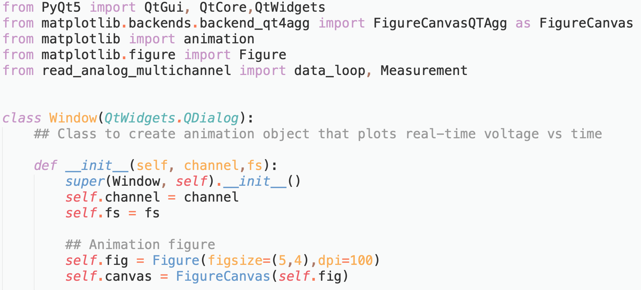
Code Development: Animation

Slide 10
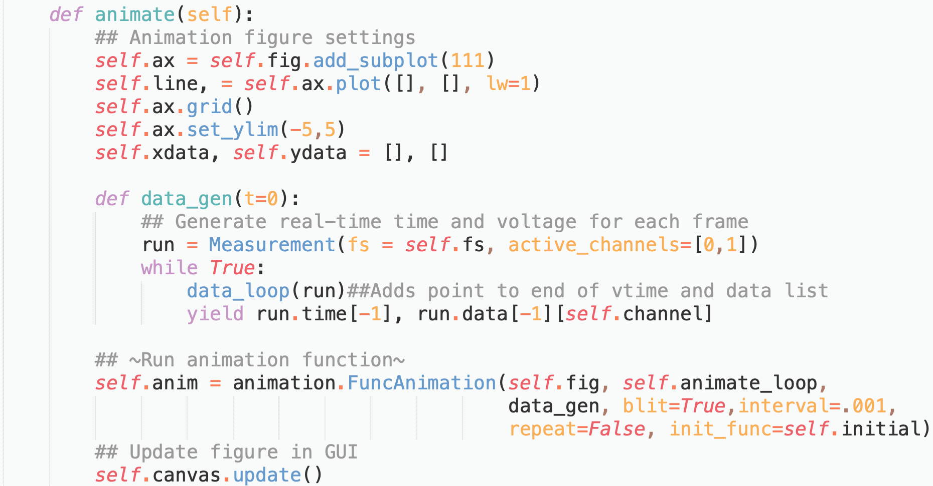
Code Development: Animation

Slide 11
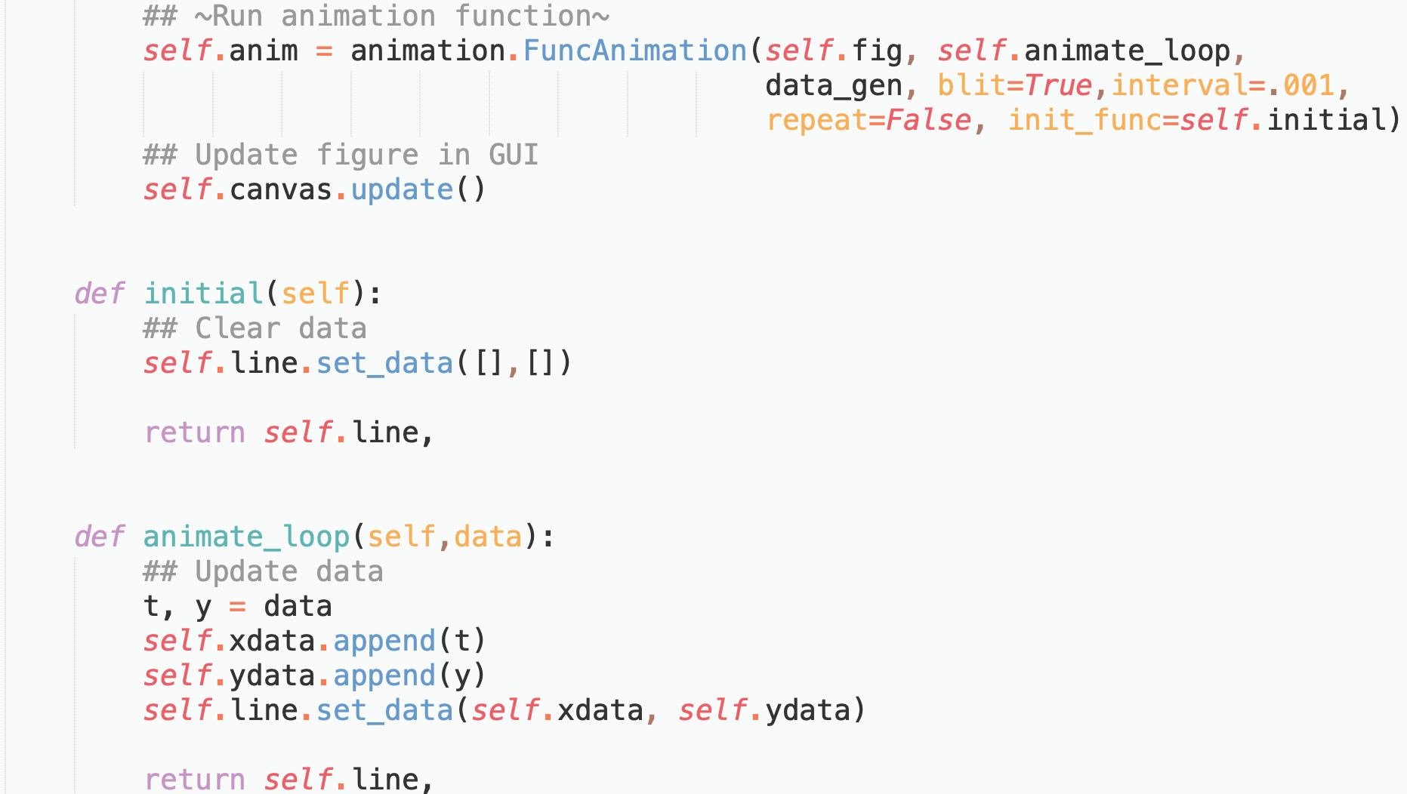
Code Development: Animation

Slide 12
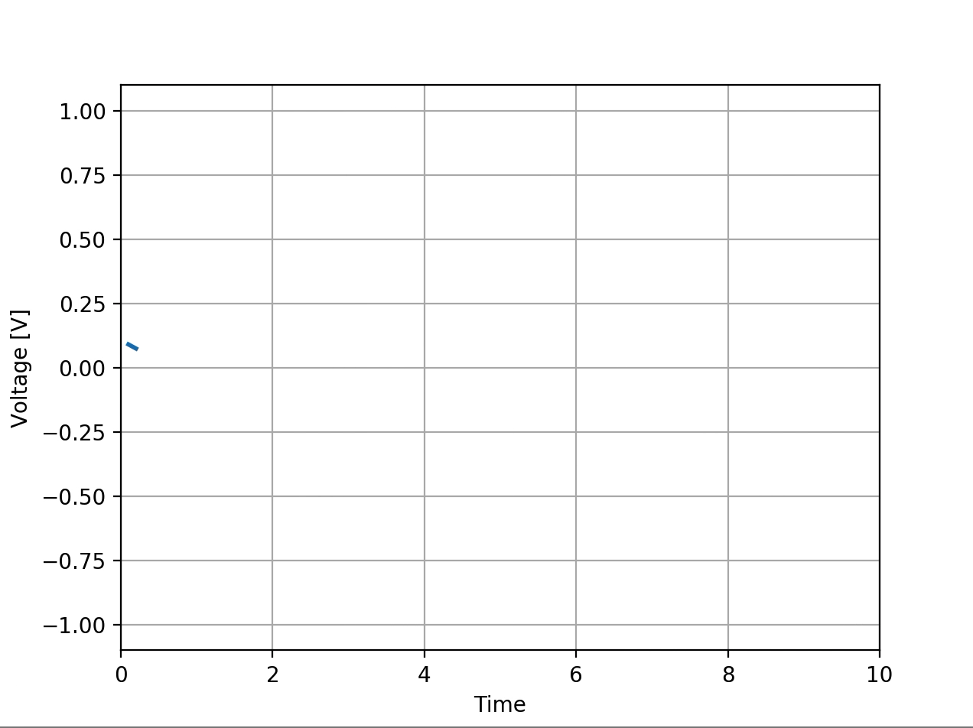
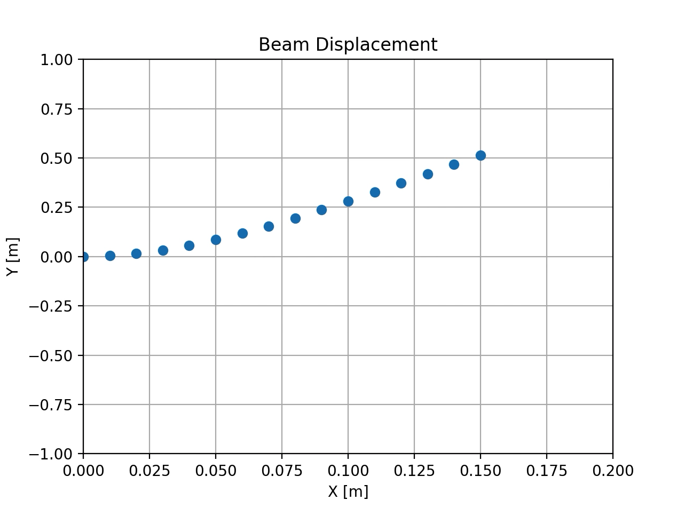
Code Development: Animation
Simulated Voltage Outputs:
Simulated Beam Displacement Animation:

Slide 13
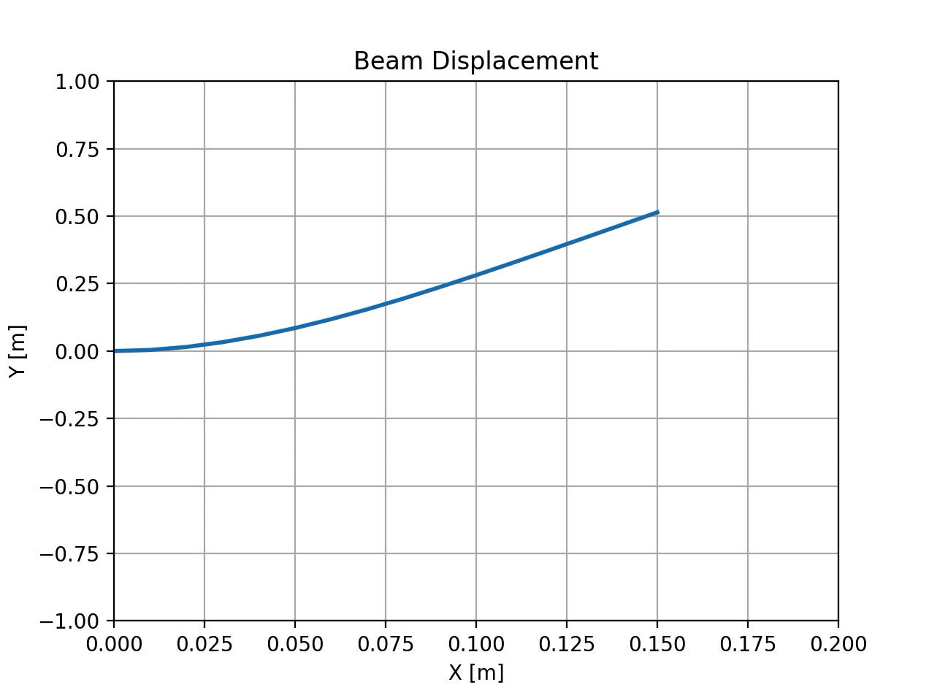
Code Development: Animation
Simulated Voltage Outputs:
Simulated Beam Displacement Animation:

Slide 14
Future Work
Saving data to file in the GUI
Interfacing setup with hydraulic servos

Slide 15
Questions or Comments?

